Slide 1


City of Arcadia
Redistricting Community Workshop

Slide 2
2021 Arcadia Redistricting
The 2021 redistricting process
  Project timelines
  Key deadlines
  Next steps and hearings
  Project website – ArcadiaCA.gov/redistricting

Slide 3
Arcadia Elections
Mayor & Council Members hold 4 -year terms
  Districts 1 & 4 terms end November 2024*
  Districts 2, 3, 5 terms end November 2022*
  *City changed election dates from April to November in order to comply with California’s SB 415

Slide 4
Redistricting Process
Step | Description
Initial Pre-Draft Hearing(s) August 17 and November 10 | Held prior to release of draft maps. Education and to solicit input on the communities in the City. Identify “neighborhoods,” “communities of interest,” and “secondary areas.”
Initial deadline for draft maps January 15 | Deadline for the public to submit draft maps for inclusion in the next hearing packet and presentation
Release draft maps | Draft maps posted to project website
Two hearings on draft maps February 1 and March 15 | Two meetings to discuss and revise the draft maps and to discuss the election sequence.
Map adoption | Map adopted via ordinance. Final map must be posted at least 7 days prior to adoption, March 8

Slide 5
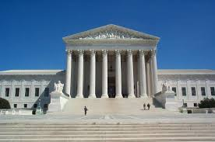
Redistricting Rules and Goals
1. Federal Laws
2. California Criteria for
Cities
3. Other Traditional Redistricting Principles
Equal Population
Federal Voting Rights Act
No Racial Gerrymandering
Geographically contiguous
Undivided neighborhoods and “communities of interest”
(Socio-economic geographic areas that should be kept together)
Easily identifiable boundaries
Compact
(Do not bypass one group of people to get to a more distant group of people)
Prohibited:
“Shall not favor or discriminate against a political party.”
Minimize voters shifted to different election years
Respect voters’ choices / continuity in office
Future population growth
Preserving the core of existing districts

Slide 6
Arcadia Demographic Overview
City of Arcadia - 2020 Census Data Total Population Statistics
District | CA Adjusted Pop. | Deviation | % Deviation | % Hispanic Origin | % NH White | % NH Black | % NH Asian
1 | 11,330 | -26 | -0.23% | 13.56% | 18.60% | 1.68% | 64.95%
2 | 10,265 | -1091 | -9.61% | 14.71% | 25.20% | 1.96% | 56.43%
3 | 12,148 | 792 | 6.97% | 17.05% | 15.06% | 2.86% | 63.26%
4 | 11,890 | 534 | 4.70% | 8.27% | 14.10% | 1.49% | 74.52%
5 | 11,148 | -208 | -1.83% | 11.98% | 16.04% | 1.15% | 69.09%
 |  | Total Deviation | 16.58%
City of Arcadia CVAP Data
District | Latino CVAP | White CVAP | Black CVAP | Asian CVAP
1 | 8.24% | 29.17% | 2.54% | 59.29%
2 | 13.49% | 38.26% | 2.38% | 45.37%
3 | 16.69% | 26.09% | 5.04% | 51.95%
4 | 6.60% | 22.06% | 1.66% | 68.28%
5 | 9.11% | 25.15% | 0.48% | 64.36%
Tables show official 2020 demographic data
Each of the 5 districts must contain about 11,356 people.

Slide 7
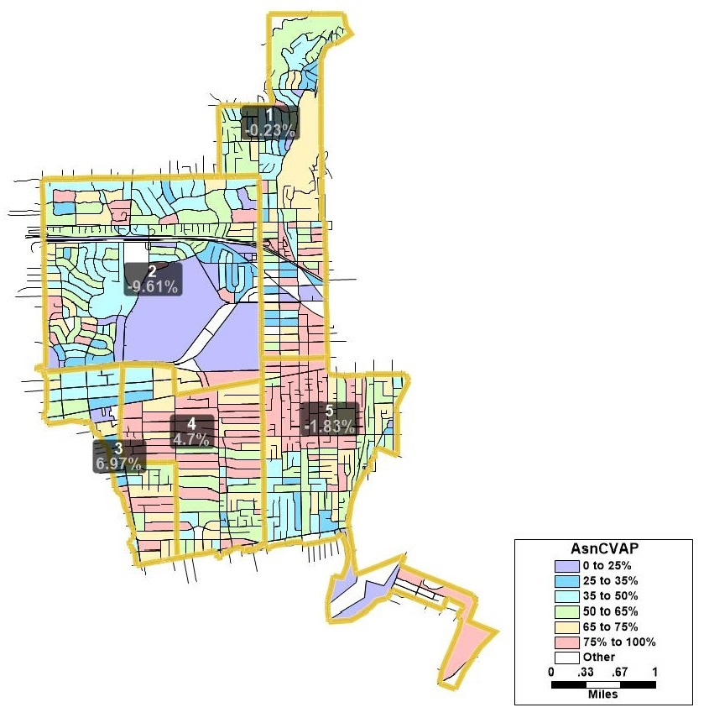
Asian-American CVAP

Slide 8
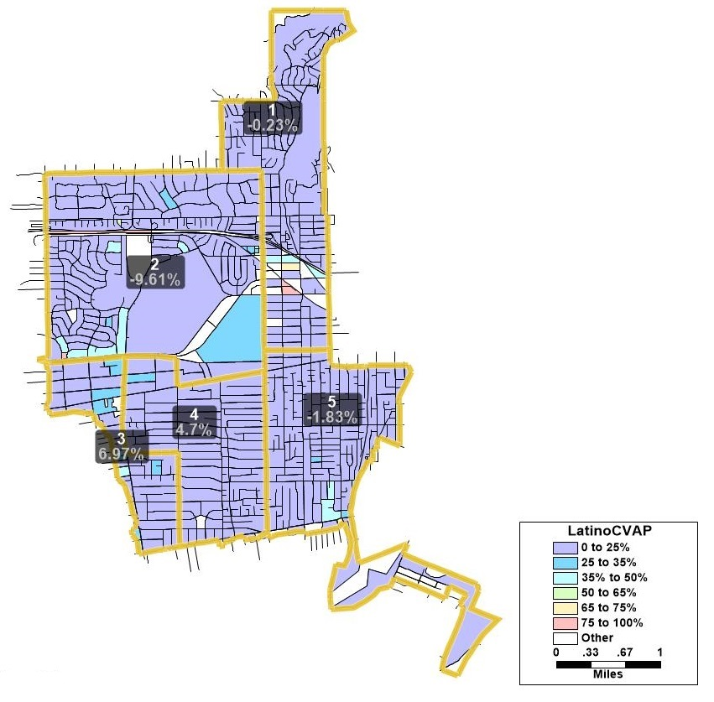
Latino CVAP

Slide 9
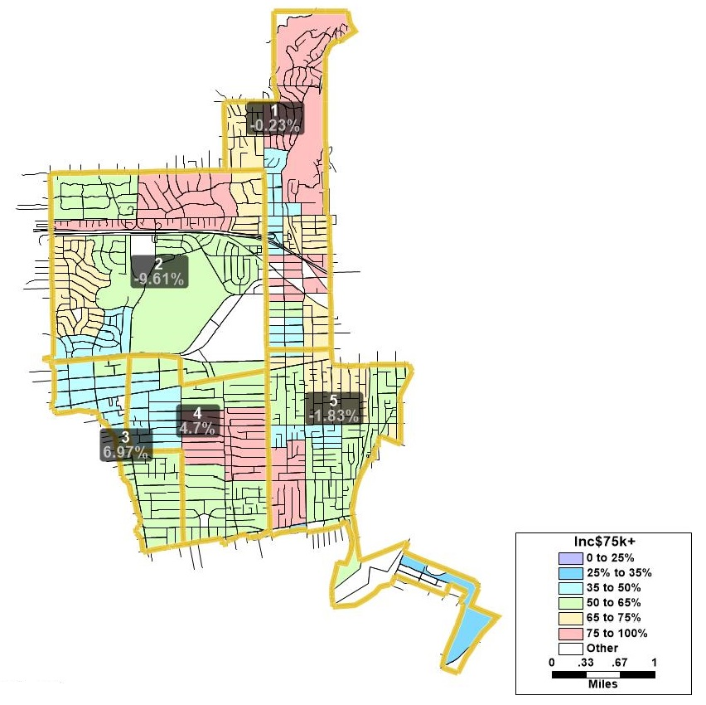
Income

Slide 10

Defining Neighborhoods
1st Question: what is your neighborhood?
2nd Question: what are its geographic boundaries?
Examples of physical features defining a neighborhood boundary:
Natural neighborhood dividing lines, such as highway or major roads, rivers, canals and/or hills
Areas around parks or schools
Other neighborhood landmarks
In the absence of public testimony, planning records and other similar documents may provide definition.

Slide 11
Beyond Neighborhoods:
Defining Communities of Interest
1st Question: what defines your community?
Geographic Area, plus
Shared issue or characteristic
  Shared social or economic interest
  Impacted by city policies
Tell us “your community’s story”
2nd Question:
Would this community benefit from being “included within a single district for purposes of its effective and fair representation”?
Or would it benefit more from having multiple representatives?
Definitions of Communities of Interest may not include relationships with political parties, incumbents, or political candidates.

Slide 12
Possible Neighborhoods / Communities
Neighborhoods
Commercial Areas
HOAs
Other designated areas

Slide 13
Discussion
What is your neighborhood and what are its boundaries?
What other notable areas are in the city, and what are their boundaries?
Any questions about the mapping tools?
Provide us Feedback on:
  Areas that meet each AB 849 definition:
    “neighborhoods”
    “communities of interest . . . that should be included within a single district for purposes of its effective and fair representation.”

Slide 14
Timeline & Next Steps
Date(s) | Description | Comments
August 17, 2021 | 1st Public Hearing
October 2021 | Mapping software released to the public. US Census data released mid-August. California released the prisoner-adjusted redistricting data on September 27
November 10, 2021 | Proposed 2nd hearing – Community Workshop
January 15, 2022 | Maps due from public
February 1, 2022 | Proposed 3rd hearing
March 8, 2022 | Publish revised map(s) | 7 Days prior to adoption
March 15, 2022 | Proposed 4th hearing. | Final Hearing and Council adopt District map. Must be completed no later than April 17, 2021
April 17, 2022 (E-205) | City deadline to adopt and submit map to Registrar

